Slide 1
19CS3113S
Analysis and Design of Algorithms
Session – 35

Slide 2
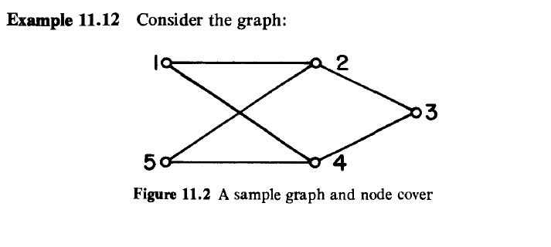
Node Cover Decision Problem(NCDP):
A set S ⊆ V is a node cover for a graph G = (V,E) if and only if all edges in E are incident to at least one vertex in S. The size |S| of the cover is the number of vertices in S.
S = {2,4} is a node cover of size 2.
S = { 1,3,5} is a node cover of size 3.

Slide 3
In a node cover decision problem we are given a graph G and an integer k.
We are required to determine whether G has a node cover of size at most k.
Theorem: The clique decision problem α the node cover decision problem.
Proof: let G = (V,E) and k define an instance of CDP. Assume that |V| = n.
We Construct a Graph G’ such that G’ has a node cover of size at most n-k if and only if G has a clique of size at least k.
Graph G’= (V,E) = ,where E = {(u,v) | u ϵ V, v ϵ V and (u,v) ɇ E}.
The set G’ is known is the complement of G

Slide 4
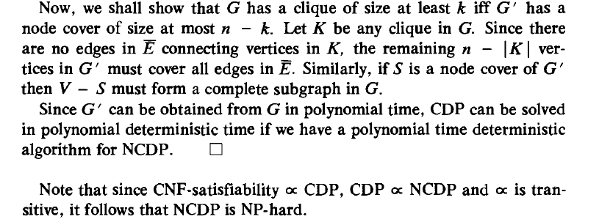

Slide 5
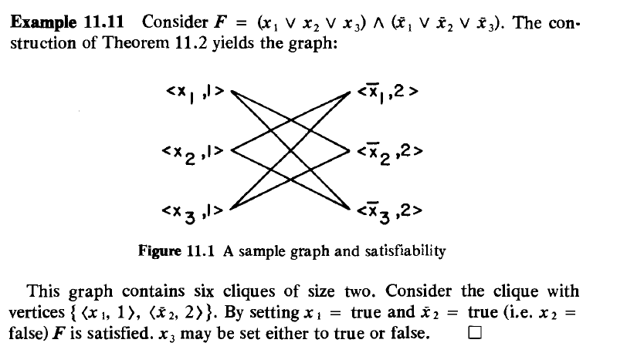

Slide 6
Thank you

